Slide 1
RICH Mirror Alignment
20/06/2016 Paras Naik, Claire Prouve, Anatoly Solomin + more

Slide 2
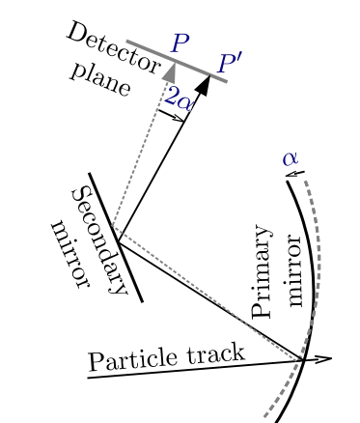
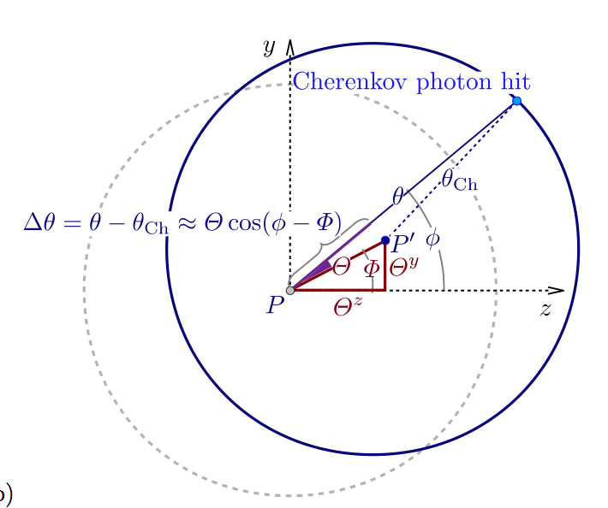
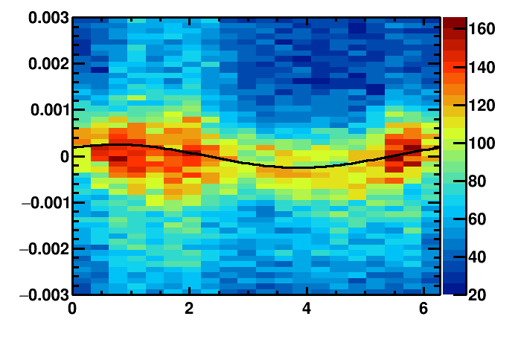
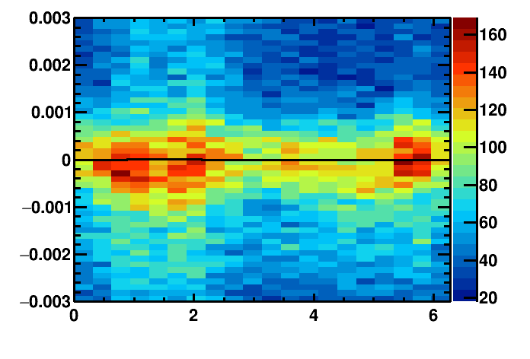
Misalignment
Detector plane
Identify misalignment:
Misalignment
Δθ_{C}(Φ) = θ_{meas.}- θ_{exp.}
Δθ_{C}(Φ) = Θ^{y}_{p,s} cos(Φ) + Θ^{z}_{p,s} sin(Φ)
Proj. Track position
Real track position
Misalignments on detector plane
Misaligned mirror:
Aligned mirror:
Cherenkov angle resolution / rad
Cherenkov angle resolution / rad
azimuthal angle/ rad
azimuthal angle/ rad

Slide 3
Overview of the procedure
Events from HLT1 line

Slide 4
Run I vs. Run II
Run I:
Offline, after data taking
with Ganga for the Brunel reconstruction
Alignment applied at the end-of-year reprocessing
Run II:
Online: after HLT1 and before HLT2
HLT farm (~1700 nodes)
Alignment runs automatically for each Fill in monitoring mode since end of May
HLT1 lines for each RICH detector ➔ triggers on tracks that populate the outer mirrors

Slide 5
What’s new in 2016?

Slide 6
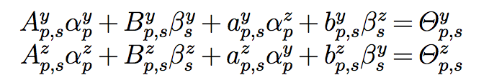
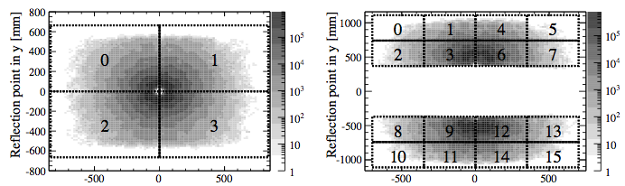
Disentangling mirror-pairs
Each pair of primary mirror p and secondary mirror s has 2 equations:
Δθ_{C}(Φ) = Θ^{y}_{p,s} cos(Φ) + Θ^{z}_{p,s} sin(Φ)
Magnification factors individual mirror tilts
Challenge: not enough information to fully constrain the solution
sss
RICH1: 8 equations for 10 unknowns aaa
Rotation of primary mirrors followed by according rotation of secondary mirrors yields same results s
➔ Need additional constraint
RICH1 primary mirrors
RICH1 secondary mirrors

Slide 7
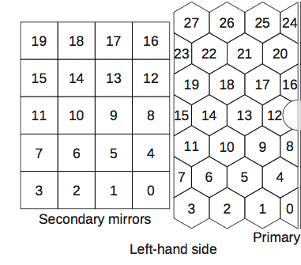
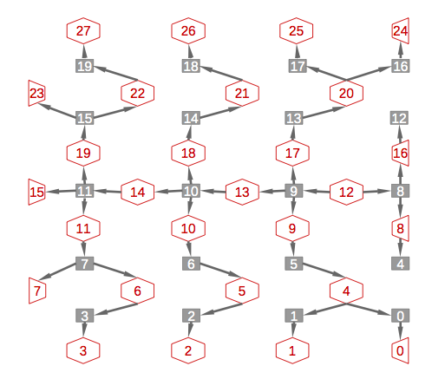
Disentangling – until 2016
Primary mirrors
Secondary mirrors
RICH1:
fix primary mirrors, align secondary mirrors
RICH2:
Left half: system of equations linking all mirrors starting from primary mirror 12.
Andrew Cook
primary mirrors, secondary mirrors
7

Slide 8


Disentangling – from 2016
L2 regularization (ridge regression): d
rewrite problem as
Minimize: least square method L2 regularization term
Advantages:
more stable than the previous method
Stable w.r.t. small statistical fluctuations (unlike L1 regularization)
➔ Fewer iterations needed to converge
Vector of results of fit to histograms
Matrix of
magnification factors
Vector of individual mirror tilts

Slide 9
Recent results

Slide 10
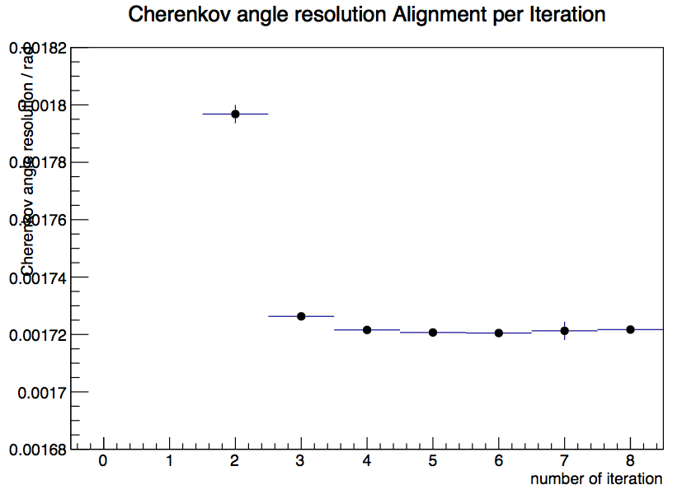
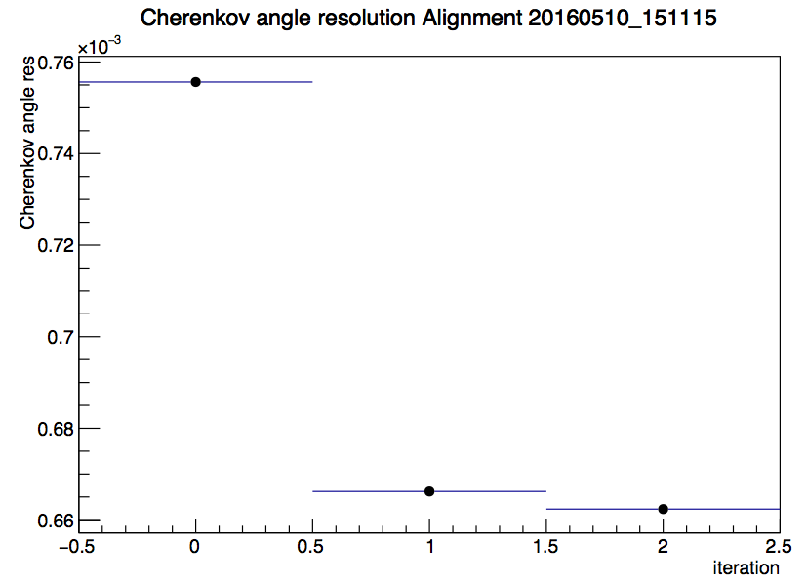
First alignment 2016
In the global tag cond-20160517
Started from completely unaligned mirrors
RICH1 Cherenkov angle resolution per iteration of first alignment 2016
RICH2 Cherenkov angle resolution per iteration of first alignment 2016
Fluctuation of single mirror due to not-optimal data sample

Slide 11
Stability of tilts – RICH1
Mag Up
Mag Down
Changes of mirror tilts wrt current DB
# of alignment run between 24/05 - 19/06

Slide 12
Stability of tilts – RICH1
Mag Down
Mag Up
Convergence criteria
0.1 mrad

Slide 13
Stability of tilts – RICH2
Convergence criteria
0.1 mrad

Slide 14
Stability of Resolution
Resolutions from refractive index calibration (without HPD image correction).
magnet down
magnet up
magnet down before new DB

Slide 15
More very new features
Different convergence criteria for primary and secondary mirrors in y and z respectively
Possibility to automatically compare output of alignment with another given alignment ➔ during MagUP start from MagUP alignment (which is not in the database currently) ➔ converge within few iterations ➔ calculate the difference to alignment in the current Conditions Database
Iterations needed to converge
27min.
12min.
6min.

Slide 16
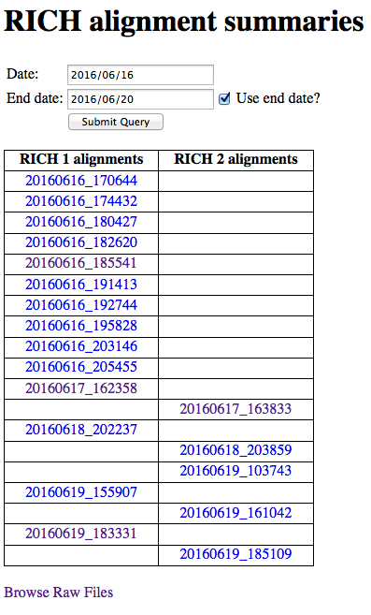
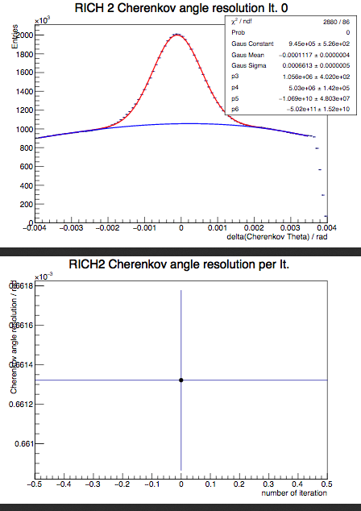
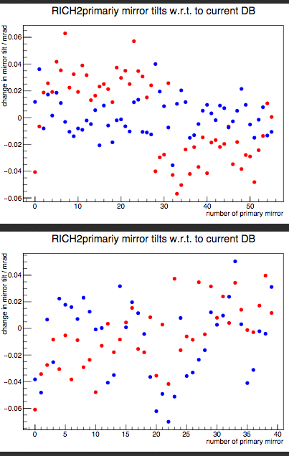
Current ‘monitoring’
https://lbgroups.cern.ch/rich/alignmentview.php
Tilts in y
Tilts in z
primary
secondary
secondary

Slide 17
Backup

Slide 18
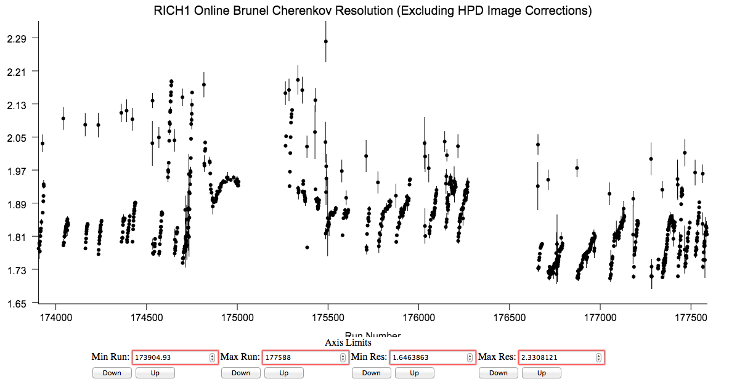
Resolution
Without HPD image correction: Degradation of resolution over fill.
➔ Longer fills in 2016
magnet down
magnet up
magnet down before new DB

Slide 19
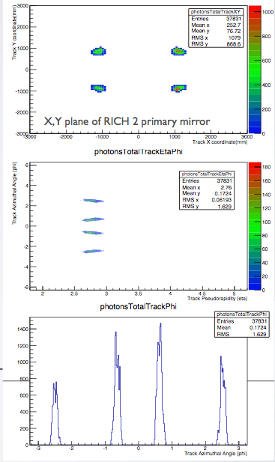
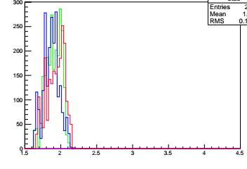
New HLT Lines
Trigger on tracks that will populate the hardest-to-populate mirror-pairs
usually the very outer mirrors
Other tracks in the events will populate the rest
RICH2
Track azimuthal angle / rad
RICH2 line:
p > 40 GeV && χ² < 2 && 2.65 < η < 2.80
(-2.59 < Φ < -2.49) || ( -0.65 < Φ < -0.55) || (0.45 < Φ < 0.65) || (2.49 < Φ < 2.59)
Track pseudorapidity
RICH1
RICH1 line:
p > 10 GeV && χ² < 2 && 1.6 < η < 2.04
(-2.65 < Φ < -2.3) || (-0.8 < Φ < -0.5) || (0.5 < Φ < 0.8) || (2.3 < Φ < 2.65)
Need to reconstruct ~10 times less events!
Track pseudorapidity

Slide 20



Magnification coefficients
Magnification coefficients: Translate the tilt on the detector plane into actual mirror tilts
Magnification coefficients are calculated new for each iteration:
Introduce 8 rotations: primary and secondary mirrors rotated around ±y and ±z axis respectively
Rotate about 0.3 mrad ( half the resolution of RICH2)
Reconstruct events for each rotation and evaluate the tilts on the detector plane
Need to reconstruct all events 9 times!
Misalignments on detector plane
Mirror tilts

Slide 21
Further improvements
Magnification coefficients:
translate the misalignment-on-the-detector-plane into actual mirror tilts
Previously calculated for every alignment for each iteration on data
Tested using the same set for all alignments and all iterations
No significant difference in resulting mirror tilts and procedure 9 times faster!!!
Improved method for fitting histograms:
use same Gaussian width for each slice in phi
Same resulting mirror-tilts and 3 times faster
Δθ/ mrads
Φ angle/ rad

